Slide 1
Energy, Work, Power, and Mechanical Advantage

Slide 2
14) explain the relationship between work and power (using narrative and mathematical descriptions) and apply to realistic situations (GPS, HSGT) (SCPH_C2005-14)
  14a) calculate the work on a body by constant force
  14b) determine experimentally the work and power done by a constant force (GPS)
  14c) calculate work, efficiency and mechanical advantage using simple machines (GPS)
18) identify and describe a system of torque-producing forces acting in equilibrium (GPS, HSGT)
  18a) solve problems (mathematically and experimentally) using the equation torque = lever arm x force (GPS)
  18b) explain the effects of changes of force and/or distance in determining torque of a system in equilibrium (GPS)
15) apply the Law of Conservation of Energy to describe conceptually and solve mathematically the conversions between potential and kinetic energy (GPS, HSGT)
  15a) identify different forms of energy to determine the transformation of energy from one form to another recognizing the conservation principle (GPS)
  15a1) mathematically determine the transformation of energy from one form to another recognizing the conservation principle (GPS)
  15b) calculate the changes (mathematically and experimentally) in gravitational potential energy in a uniform field
  15c) calculate the changes (mathematically and experimentally) in kinetic energy due to changes in potential energy or by work done by an outside force

Slide 3
Intro
What would happen to the force of gravity if you doubled the mass of one object and tripled the distance it is away from the other.
What would happen to the tension in a rope (equal to F_{c}) it your doubled the radius of the rope you were swinging around?

Slide 4

Work
Work is done when a force acts on an object and moves it a certain distance.
Work = net force x distance
W=Fd
The unit for work is the
Joule which is a N·m
d = 2.5 m
500 N of force applied

Slide 5
Ex A. How much work is being done by a weightlifter below that applies 500 Newtons of force lifting a mass 2.5 meters?
F= 500 N
d = 2.5 m
W=Fd
W= (500)(2.5) = 1250 J
d = 2.5 m
500 N of force applied

Slide 6

Ex B. How much work is being done by a weightlifter below that applies 1000 Newtons of force but does not move the mass?
F= 1000 N
d = 0 m
W=Fd
W= (1000)(0) = 0 J

Slide 7
Work
W=Fd
No work is done if the object does not travel a distance

Slide 8

Power
Power is the rate at which work is done. Work divided by time
Fd
t
P = _____
or

Slide 9
Unit of Power
The unit of power would be joules per second or the watt
A watt equals one joule of energy in one second

Slide 10
Ex C. A weightlifter who does 1250 Joules of work in 0.5 s applies how much power?
W= 1250J
t= 0.5s
P= W/t
P= 1250/0.5 = 2500 watts
d = 2.5 m
500 N of force applied

Slide 11

Ex D. A weightlifter pulls with 500N of force lifting an object 2.5m in 1.5s. How much power did he apply?
F= 500 N
d = 2.5 m
t= 1.5 s
P= (Fd)/t = ((500)(2.5))/1.5 = 833 watts
d = 2.5 m
500 N of force applied

Slide 12
Ex. E: A girl weighing 500 Newtons takes 50 seconds to climb a flight of stairs 18 meters high. What is her power output vertically?

Slide 13
Ex. E: A girl weighing 500 Newtons takes 50 seconds to climb a flight of stairs 18 meters high. What is her power output vertically?

Slide 14
20N
Problem Set #1
A 20 N force is used to push a 2.00 kg cart a distance of 5 meters. What is the work done on the cart?
How much power is needed to do push the cart in the example above in 7 seconds?
A girl weighing 300 Newtons takes 45 seconds to climb a flight of stairs 24 meters high. What is her power output vertically?
2.0kg
5m

Slide 15
20N
Problem Set #1
A 20 N force is used to push a 2.00 kg cart a distance of 5 meters. What is the work done on the cart?
2.0kg
5m

Slide 16
Problem Set #1
2. How much power is needed to do push the cart in the example above in 7 seconds?

Slide 17
Problem Set #1
3. A girl weighing 300 Newtons takes 45 seconds to climb a flight of stairs 24 meters high. What is her power output vertically?

Slide 18
Intro
Jill lifts an object with a weight of 100 N one meter high. How much work did she do.
Jill lifts an object with a mass of 5 kg one meter high. How much work did she do?
Which of the following boxes have more work done on them to move them 5m?
F= 100 N
F= 100 N
A
B
5m
5m

Slide 19
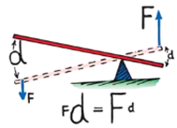
Machines
Simple Machine- a device used to magnify forces or simply change the direction of forces.
Conservation of energy:
Energy is not created nor destroyed
Work input = work output
Work_{input} = Work_{output}
Fd_{in} = Fd_{out}

Slide 20
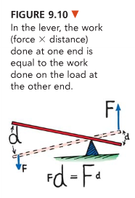
Example Simple Machines
Lever- a simple machine made of a bar that turns around a fived point

Slide 21
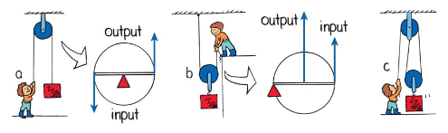
Example Simple Machines
Pulley- a basic lever that can change the direction of force.
If properly used a pulley system can multiply force
Pulley System

Slide 22
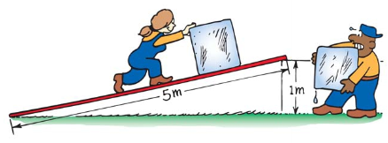
Example Simple Machines
Incline Plane- A surface at a slope
Sliding a load up an incline requires less force than lifting it up but you have to apply the force over a longer distance.

Slide 23
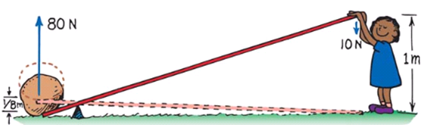

All simple machines follow the conservation of energy in an
(in the absence of friction)
F_{in}d_{in} = F_{out}d_{out}
Out:
80 N over 1/8 m
In:
10 N over 1 m
In:
10 N over 2 m
Out:
20 N over 1 m
In:
10 N over 5 m
Out:
50 N over 1 m

Slide 24
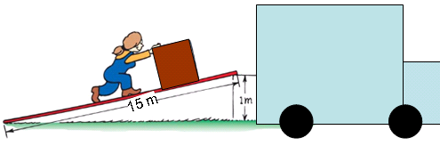
Ex. E: Sally pushes a box up a ramp using a 15m plank. The box moves a vertical distance of 1m and weighs 500 N, ideally with how much force must she push?

Slide 25
Ex. E: Sally pushes a box up a ramp using a 15m plank. The box moves a vertical distance of 1m and weighs 500 N, ideally with how much force must she push?

Slide 26
Ex. F: Eldred lifts a 110 N box a distance of 1.5 meter using a pulley system. She pulls the rope for 3 meters to accomplish this. With what ideal constant force must she pull?

Slide 27
Ex. F: Eldred lifts a 110 N box a distance of 1.5 meter using a pulley system. She pulls the rope for 3 meters to accomplish this. With what ideal constant force must she pull?

Slide 28
Mechanical Advantage
Mechanical advantage: how many times more force you get out of a simple machine
A mechanical advantage of 6 means the machine outputs 6 times more force
Machine
w/
6 M.A.
10 N in
60 N out

Slide 29
No machine is 100% efficient because of friction and loss of energy through heat
W_{out}
W_{in}
Efficiency = ______ x 100%
AMA
IMA
Efficiency = ______ x 100%

Slide 30
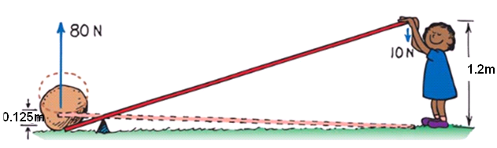

Ex. G:
a. how much work is put into this machine?
b. how much work does the machine output?
c. What is the efficiency of this machine?
F_{in}:10N
d_{in}:1.2m
W_{in}:?
F_{out}:80N
d_{out}:0.125m
W_{out}=?
W=Fd

Slide 31
Ex. G:
a. how much work is put into this machine?
b. how much work does the machine output?
c. What is the efficiency of this machine?
F_{in}:10N
d_{in}:1.2m
W_{in}:?
F_{out}:80N
d_{out}:0.125m
W_{out}=?
W=Fd

Slide 32
Ex. G:
a. how much work is put into this machine?
b. how much work does the machine output?
c. What is the efficiency of this machine?
F_{in}:10N
d_{in}:1.2m
W_{in}:?
F_{out}:80N
d_{out}:0.125m
W_{out}=?
W=Fd

Slide 33
Ex. G:
a. how much work is put into this machine?
b. how much work does the machine output?
c. What is the efficiency of this machine?
F_{in}:10N
d_{in}:1.2m
W_{in}:?
F_{out}:80N
d_{out}:0.125m
W_{out}=?
W=Fd

Slide 34

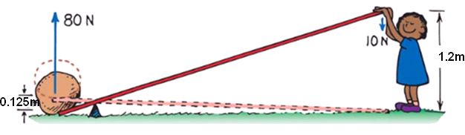
Ideal Mechanical Advantage
Ideal Mechanical Advantage- The mechanical advantage you should get out of a simple machine ignoring friction. What you should get based on distance.

Slide 35

Actual Mechanical Advantage
Actual Mechanical Advantage- ratio of input to output force. How much your force is actually multiplied

Slide 36
Ex. H: What is the ideal mechanical advantage below?
Ex. I: What is the actual mechanical advantage below?

Slide 37
Ex. H: What is the ideal mechanical advantage below?

Slide 38
Ex. I: What is the actual mechanical advantage below?

Slide 39

(MA) Mechanical Advantage of a Simple Pulley System
MA = same as the number of strands of rope that actually support the load.
Only two strands support the load here- one is only used to change direction
MA here is 2 – The individual only has to pull with half the force but twice the distance.
1
2

Slide 40
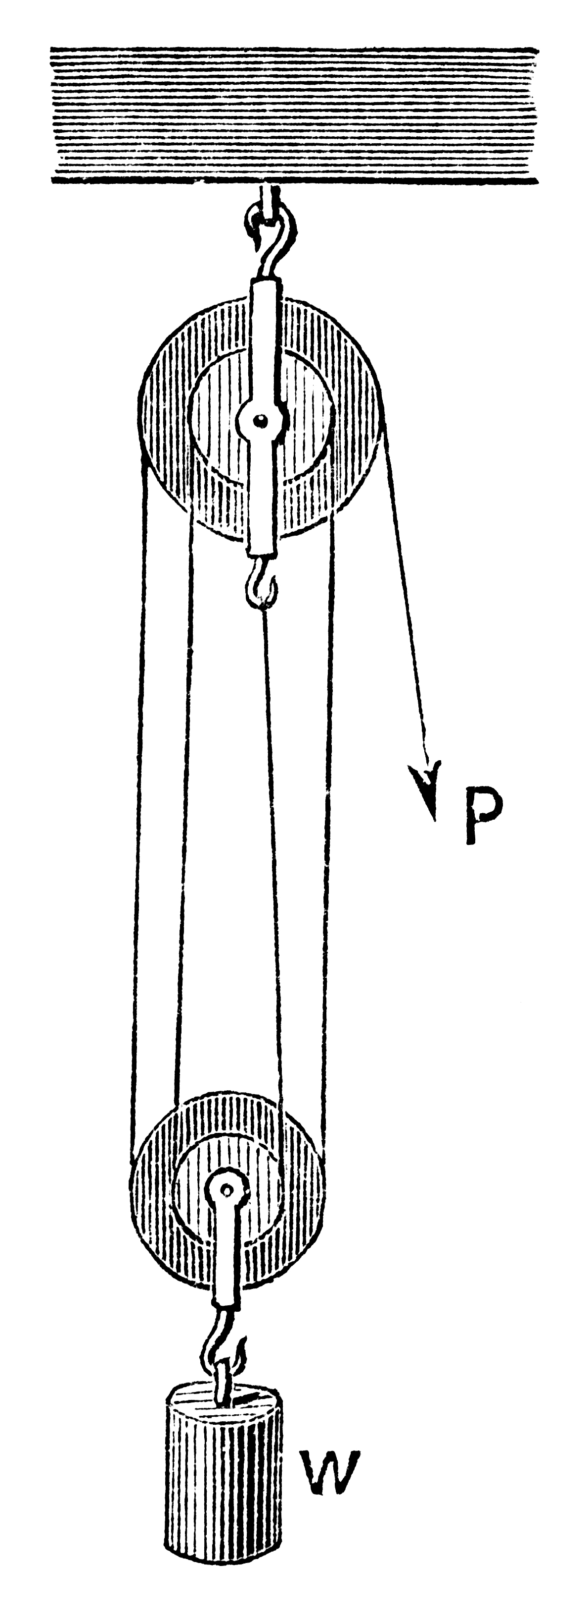
J. What would be the ideal mechanical advantage of the pulley system below?

Slide 41
J. What would be the ideal mechanical advantage of the pulley system below?

Slide 42
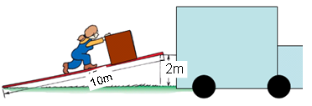
Problem Set 2
1. John pushes a box up a ramp using a 10m plank. The box moves a vertical distance of 2m and weighs 500 N, ideally with how much force must he push?
2. What is the actual mechanical advantage when you apply a force of 3N to lift a 15 N object?
3. What is the ideal mechanical advantage when you use a 8m long slab as an incline plane to lift an object 2?
4. Sam uses an inclined plane to move a 65 N box onto a loading dock. The ramp is five meters long and the loading dock is 1.5 meters high. If the loading dock height was 2.5 meters, how would the mechanical advantage of the inclined plane change?
MA would decrease
MA would increase
MA would become zero
MA would not change

Slide 43
Problem Set 2
#1 John pushes a box up a ramp using a 10m plank. The box moves a vertical distance of 2m and weighs 500 N, ideally with how much force must he push?

Slide 44
Problem Set 2
#2 What is the actual mechanical advantage when you apply a force of 3N to lift a 15 N object?

Slide 45
Problem Set 2
#3 What is the ideal mechanical advantage when you use a 8m long slab as an incline plane to lift an object 2 m?

Slide 46
Problem Set 2
#4 Sam uses an inclined plane to move a 65 N box onto a loading dock. The ramp is five meters long and the loading dock is 1.5 meters high. If the loading dock height was 2.5 meters. How would the mechanical advantage of the inclined plane change?
MA would decrease
MA would increase
MA would become zero
MA would not change

Slide 47
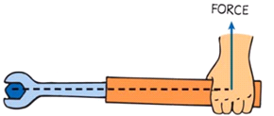
Torque (τ)
Torque (τ) : A rotational analog of force
Produces a rotational acceleration
Occurs when a force is applied to a lever with a perpendicular component.
Unit: Newton meter (N·m)
τ =F┴d
d
Torque = (force perpendicular) x ( distance of the lever arm)

Slide 48
Torque (τ)
Applying the force perpendicular gets the most torque
Fulcrum or turning point
Lever arm
d
τ = F┴d
Torque = (force perpendicular) x ( distance of the lever arm)

Slide 49
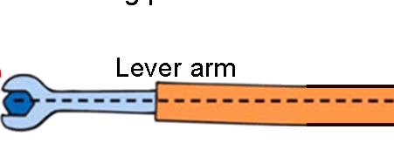

Torque (τ)
Only the perpendicular component of force goes into torque
This is not as efficient
Perpendicular component
Lever arm
Force applied
τ =F┴d
Torque = (force perpendicular) x ( distance of the lever arm)

Slide 50
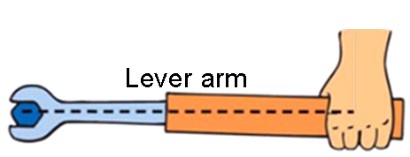
Torque (τ)
Applying the force parallel gives no torque
The perpendicular component of force equals 0
Lever arm
τ =F┴d
Torque = (force perpendicular) x ( distance of the lever arm)

Slide 51

Torque (τ)
Ex. K: Increasing the lever arm does what to torque?
Ex. L: Applying more force perpendicular does what to torque?
Ex. M: How much torque would you have if you apply a parallel force at a distance seen below?
F
τ =F┴d
Torque = (force perpendicular) x ( distance of the lever arm)

Slide 52
Torque (τ)
Ex. K: Increasing the lever arm does what to torque?
Ex. L: Applying more force perpendicular does what to torque?
Ex. M: How much torque would you have if you apply a parallel force at a distance seen below?
F
τ =F┴d
Torque = (force perpendicular) x ( distance of the lever arm)

Slide 53
N. The drawing below represents a wrench. The left end of the wrench is attached to a bolt. Four equal forces of 100N are applied as indicated in the drawing.
(a) Which of the four forces exerts the greatest torque on the bolt? (and why)
(b) Which of the four forces exerts the least torque on the bolt? (and why)
A
C
B
D

Slide 54
N. The drawing below represents a wrench. The left end of the wrench is attached to a bolt. Four equal forces of 100N are applied as indicated in the drawing.
Which of the four forces exerts the greatest torque on the bolt? (and why)
(b) Which of the four forces exerts the least torque on the bolt? (and why)
A
C
B
D

Slide 55
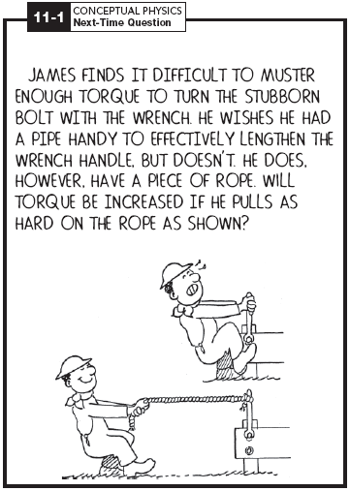
No.... lever distance is not increased

Slide 56
Ex. O: Ned tightens a bolt in his car engine by exerting a 12 N force on his wrench at a distance of 0.40 m from the fulcrum. How much torque must Ned produce to turn the bolt?

Slide 57
Ex. O: Ned tightens a bolt in his car engine by exerting a 12 N force on his wrench at a distance of 0.40 m from the fulcrum. How much torque must Ned produce to turn the bolt?

Slide 58
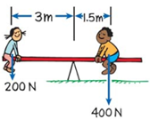
Balanced Torques (Σ τ = 0)
When balanced torques act on an object, there is no change in rotation
The heavier boy must be closer the fulcrum to balance out.

Slide 59

Simple Balanced Torques Problem
Sum of torques = 0
All clockwise torques = all counterclockwise torques
τ_{cw} = τ_{ccw}
F_{cw}d_{cw} = F_{ccw}d_{ccw}
counterclockwise
(ccw)
clockwise
(cw)

Slide 60
Ex. P: How far from the fulcrum must the boy sit to balance out the teeter totter?
F_{cw}d_{cw} = F_{ccw}d_{ccw}
(200)(3) = (400)(d_{ccw})
d_{ccw}= (200)(3) /(400)
d_{ccw}= 1.5 m
?

Slide 61
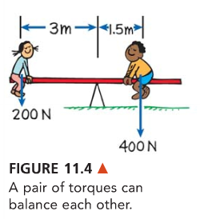
Complex Balanced Torques Problem
Sum of torques = 0
All clockwise torques = all counterclockwise torques
τ_{1cw} + τ_{2cw} + … = τ_{1ccw} + τ_{2ccw} + …
F_{1cw}d_{1cw} + F_{2cw}d_{2cw} + … = F_{1ccw}d_{1ccw} + F_{2ccw}d_{2ccw} + …

Slide 62
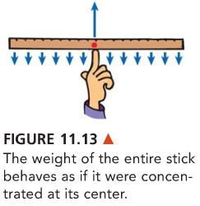
Center of gravity (CG)
The center of gravity of a uniform object is the geometric center.

Slide 63
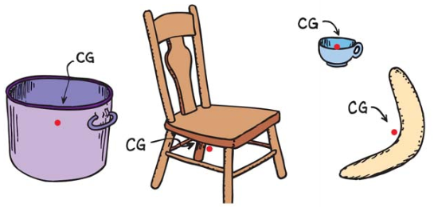
Non-uniform Objects CGs

Slide 64
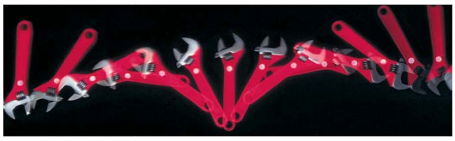
When an object is thrown it will rotate around its center of gravity

Slide 65
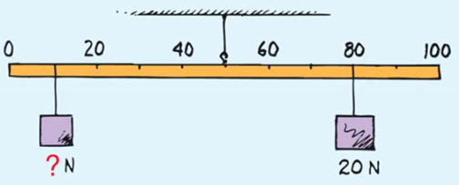
Ex. Q: What would be the weight of the block below be to balance out the torques below?
In this problem the meter sticks weight does not effect force since its center of gravity is at the fulcrum (d=0)
Do not just read the meter stick, determine how far the mass is from the fulcrum.

Slide 66
Ex. Q: What would be the weight of the block below be to balance out the torques below?

Slide 67
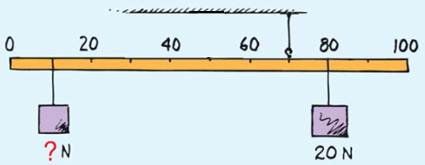
An objects mass is applied from its center of gravity.
Ex. R: If the meter stick weighed 2N with a center of gravity at the 50cm mark, what would be the weight of the block below be to balance out the torques?
2N

Slide 68
An objects mass is applied from its center of gravity.
Ex. R: If the meter stick weighed 2N with a center of gravity at the 50cm mark, what would be the weight of the block below be to balance out the torques?
2N

Slide 69
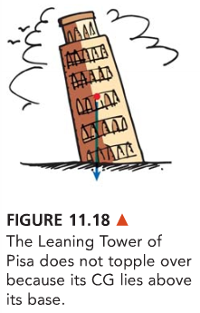
Rules for toppling
If the center of gravity lies outside the area of support an object will topple over.

Slide 70
Problem Set 3
Sam tightens a bolt in his bicycle by exerting a 15 N force on his wrench at a distance of 0.10 m from the fulcrum. How much torque must Sam produce to turn the bolt?
2. John weighs 600N and is sitting 1.5 m from the fulcrum. Where must a 450N Mary move to balance Johns weight?

Slide 71
Problem Set 3
Sam tightens a bolt in his bicycle by exerting a 15 N force on his wrench at a distance of 0.10 m from the fulcrum. How much torque must Sam produce to turn the bolt?

Slide 72
Problem Set 3
2. John weighs 600N and is sitting 1.5 m from the fulcrum. Where must a 450N Mary move to balance Johns weight?

Slide 73
Mechanical Energy
Mechanical energy- the energy due to the position of something or the movement of something.
Two types of Mechanical energy
  Kinetic Energy
  Potential Energy
The unit for all energy and work is the Joule

Slide 74
Potential Energy (PE)
Potential Energy- Energy that is stored
  Elastic Potential Energy- caused by a stretched or compressed spring
  Chemical Energy- energy in a substance (energy of position at a subatomic level released when electric charges within and between molecules are altered)
  Gravitational Potential Energy- energy due to an elevated position

Slide 75
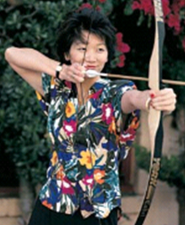
Elastic Potential Energy
Elastic potential energy = (F)(d)
Elastic potential energy equals the work done to store it
PE = (F)(d)
Ex S: How much potential energy
is in a bow pulled back 0.40m with a force of 50N?

Slide 76
Elastic Potential Energy
Ex S: How much potential energy
is in a bow pulled back 0.40m with a force of 50N?

Slide 77

Gravitational Potential Energy
Gravitational potential energy is also equal to the work done to store it
Gravitational potential energy = weight x height
PE= F_{w}h or PE= mgh
The more height or more mass the more PE
Ex T: How much potential energy
is in a 50kg boulder 3.5m off the ground?

Slide 78
Gravitational Potential Energy
Ex T: How much potential energy
is in a 50kg boulder 3.5m off the ground?

Slide 79
Ex U: Which ball has more potential energy?
50kg
50kg
10 m
6 m

Slide 80
Ex U: Which ball has more potential energy?
50kg
50kg
10 m
6 m

Slide 81
Ex V: Which ball has more potential energy?
30kg
50kg
10 m
6 m

Slide 82
Ex V: Which ball has more potential energy?
30kg
50kg
10 m
6 m

Slide 83
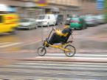
Kinetic Energy (KE)
Kinetic Energy- Energy of an object in motion
KE = ½ mass x speed²
KE = ½ mv²

Slide 84
KE = ½ mv2
Ex. W: How much kinetic energy does a 500 kg car have when moving at 20 m/s?

Slide 85
KE = ½ mv2
Ex. W: How much kinetic energy does a 500 kg car have when moving at 20 m/s?

Slide 86
Problem Set 4
1. A 0.20kg apple falls 7.0m and hits you on the head. What was the apples change in PE during the fall?
2. A greyhound can run at a speed of 16.0m/s. What is the KE of a 20.0kg greyhound running at this speed?

Slide 87
Problem Set 4
1. A 0.20kg apple falls 7.0m and hits you on the head. What was the apples change in PE during the fall?

Slide 88
Problem Set 4
2. A greyhound can run at a speed of 16.0m/s. What is the KE of a 20.0kg greyhound running at this speed?

Slide 89
Work Energy Theorem
Whenever work is done, energy changes.
Work = ΔKE
Work equals a change in kinetic energy
Net force x distance = kinetic energy
Fd = ½ mv²

Slide 90
Ex. X: If a car has a mass of 750 kg, how much force is required to stop the car if it was traveling 12.5 m/s and took 10m to stop?
Fd = ½ mv²

Slide 91
Ex. X: If a car has a mass of 750 kg, how much force is required to stop the car if it was traveling 12.5 m/s and took 10m to stop?
Fd = ½ mv²

Slide 92
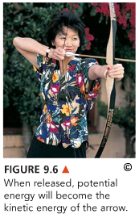
Conservation of Energy
Law of conservation of energy- energy cannot be created or destroyed. It can be transformed from one form into another, but the total energy never changes.

Slide 93
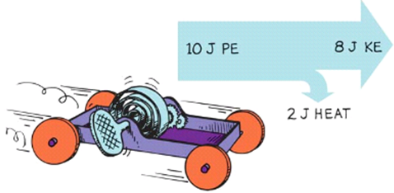
Conservation of Energy
All potential energy stored in a spring will be transformed into other forms.
Part becomes KE and the rest is lost to the surrounding as heat.

Slide 94
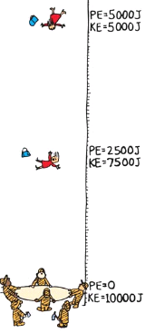
Conservation of energy formula
PE_{before} + KE_{before} = PE_{after} + KE_{after} + Heat lost
Formula in an ideal situation heat lost:
PE_{before} + KE_{before} = PE_{after} + KE_{after}
or
mgh_{before} + ½ mv²_{before} = mgh_{after} + ½ mv²_{after}

Slide 95
Mass is not needed in the conservation of energy formula
mgh_{before} + ½ mv²_{before} = mgh_{after} + ½ mv²_{after}
m m m m
gh_{before} + ½ v²_{before} = gh_{after} + ½ v²_{after}

Slide 96
Ex. Y: A pool ball is flung off of a 0.68m high table and the ball hits the floor with a speed of 6.0 m/s. How fast was the ball moving when it left the pool table?

Slide 97
Ex. Y: A pool ball is flung off of a 0.68m high table and the ball hits the floor with a speed of 6.0 m/s. How fast was the ball moving when it left the pool table?

Slide 98
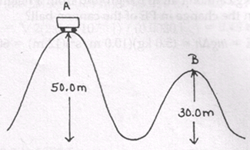
Ex. Z: A 300kg cart is going 8.0m/s when is at the top of hill A. How fast is it going at the top of hill B?

Slide 99
Ex. Z: A 300kg cart is going 8.0m/s when is at the top of hill A. How fast is it going at the top of hill B?

Slide 100
Problem Set 5
1. A one kilogram rock is dropped from a cliff. After 20 meters, the kinetic energy of the rock is approximately what?
2. A 100 kg cart accelerates from 5 m/s to 10 m/s. How does the carts final kinetic energy compare to it initial kinetic energy?
3. At which point below does the skier have the most potential energy?
4. At which point below does the skier have the most kinetic energy?
5. At which point would the skier have the most energy (ideally)?
6. Assuming that a 50kg skier started at rest. What was the velocity of the skier at point B?
D
B
45m
C
A
20m

Slide 101
Problem Set 5
1. A one kilogram rock is dropped from a cliff. After 20 meters, the kinetic energy of the rock is approximately what?

Slide 102
Problem Set 5
2. A 100 kg cart accelerates from 5 m/s to 10 m/s. How does the carts final kinetic energy compare to it initial kinetic energy?

Slide 103
Problem Set 5
2. A 100 kg cart accelerates from 5 m/s to 10 m/s. How does the carts final kinetic energy compare to it initial kinetic energy?

Slide 104
Problem Set 5
3. At which point below does the skier have the most potential energy?
4. At which point below does the skier have the most kinetic energy?
5. At which point would the skier have the most energy (ideally)?
6. Assuming that a 50kg skier started at rest. What was the velocity of the skier at point B?
D
B
45m
C
A
20m

